Slide 1
Smel Lab
Student Research
2021/2 ~ 2022/1
20193852 문유빈

Slide 2
Abstract

Slide 4
Introduction

Slide 5
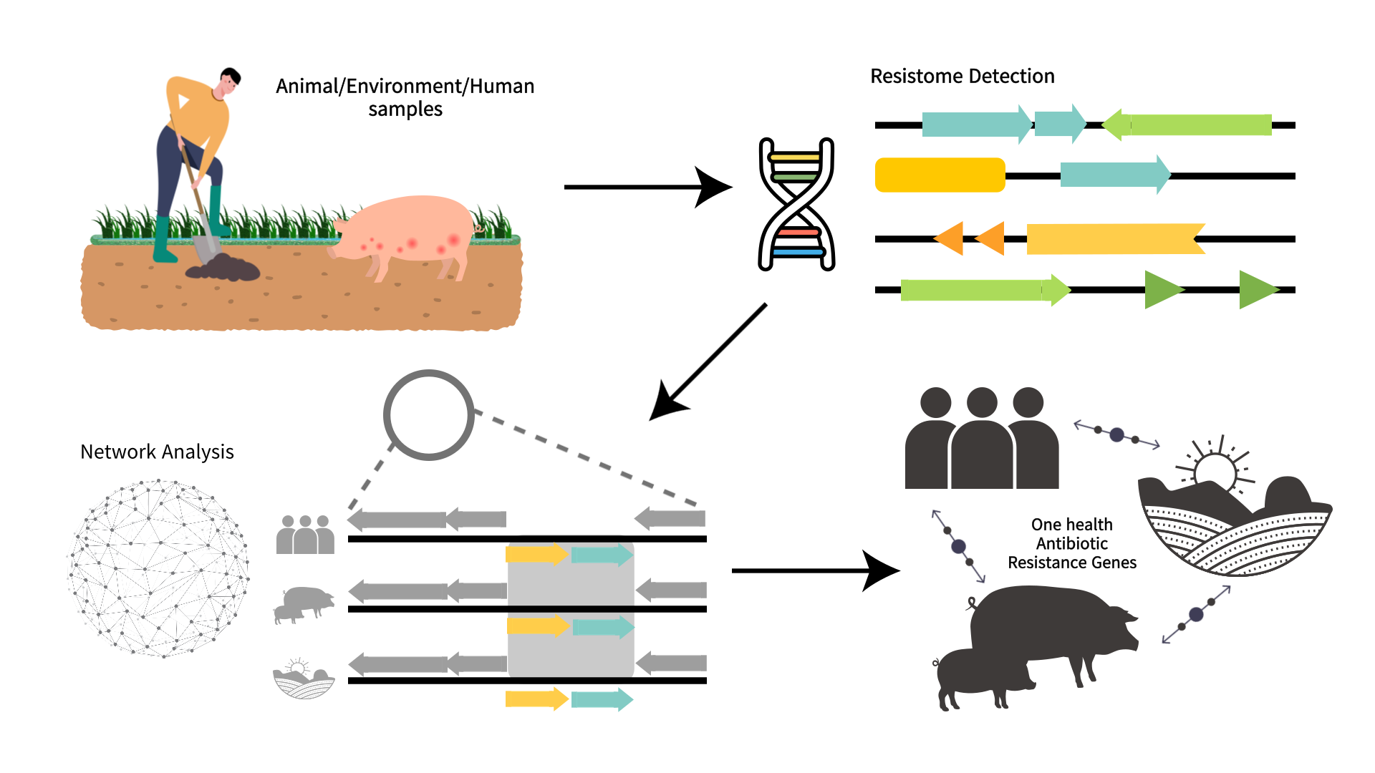
Introduction

Slide 6
Result

Slide 7
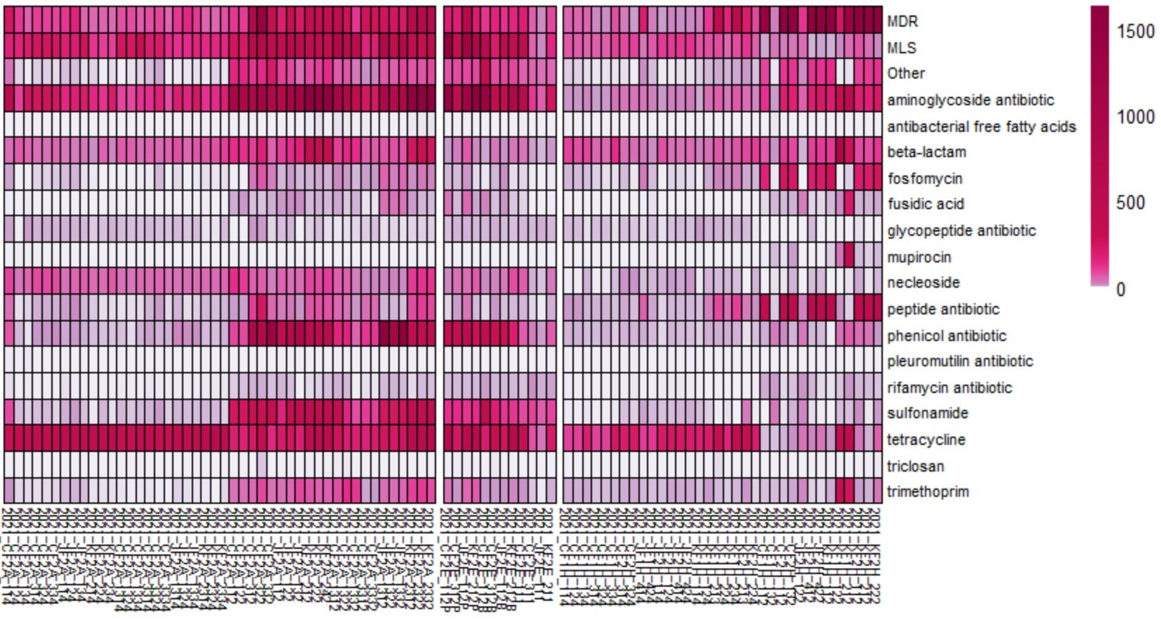
All samples heatmap in R
Lactating pig
Finishing pig
Lactating pig
Finishing pig
Fecal
Nasal
Lactating
pig farm
finishing
Pig farm
Wastewater
Fecal
Nasal
Animal
Environment
Human

Slide 8
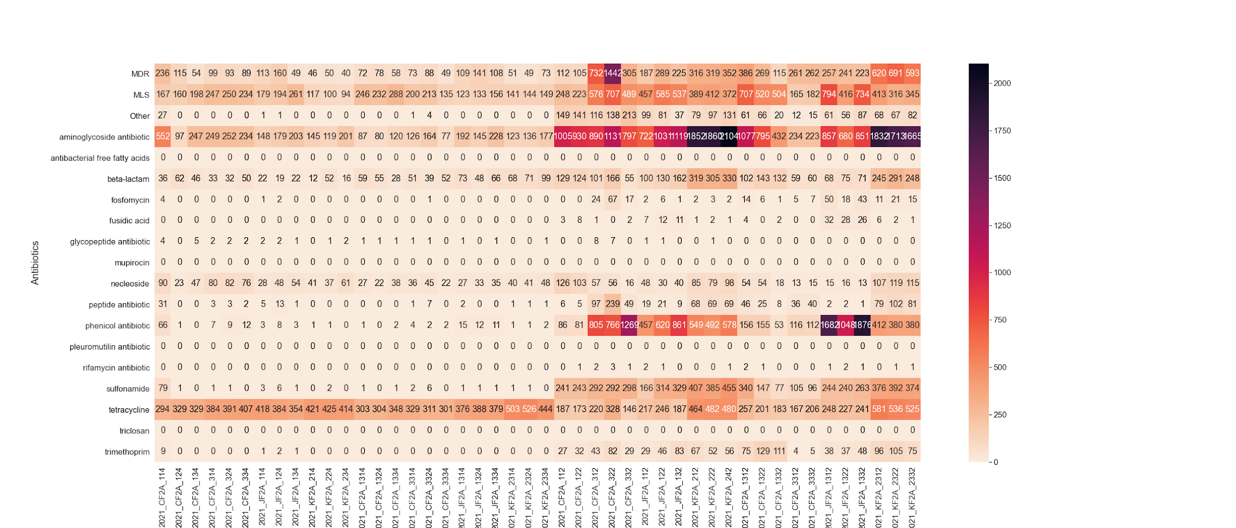
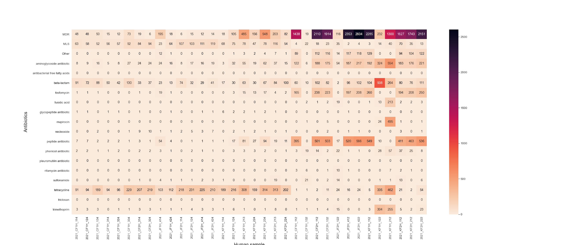
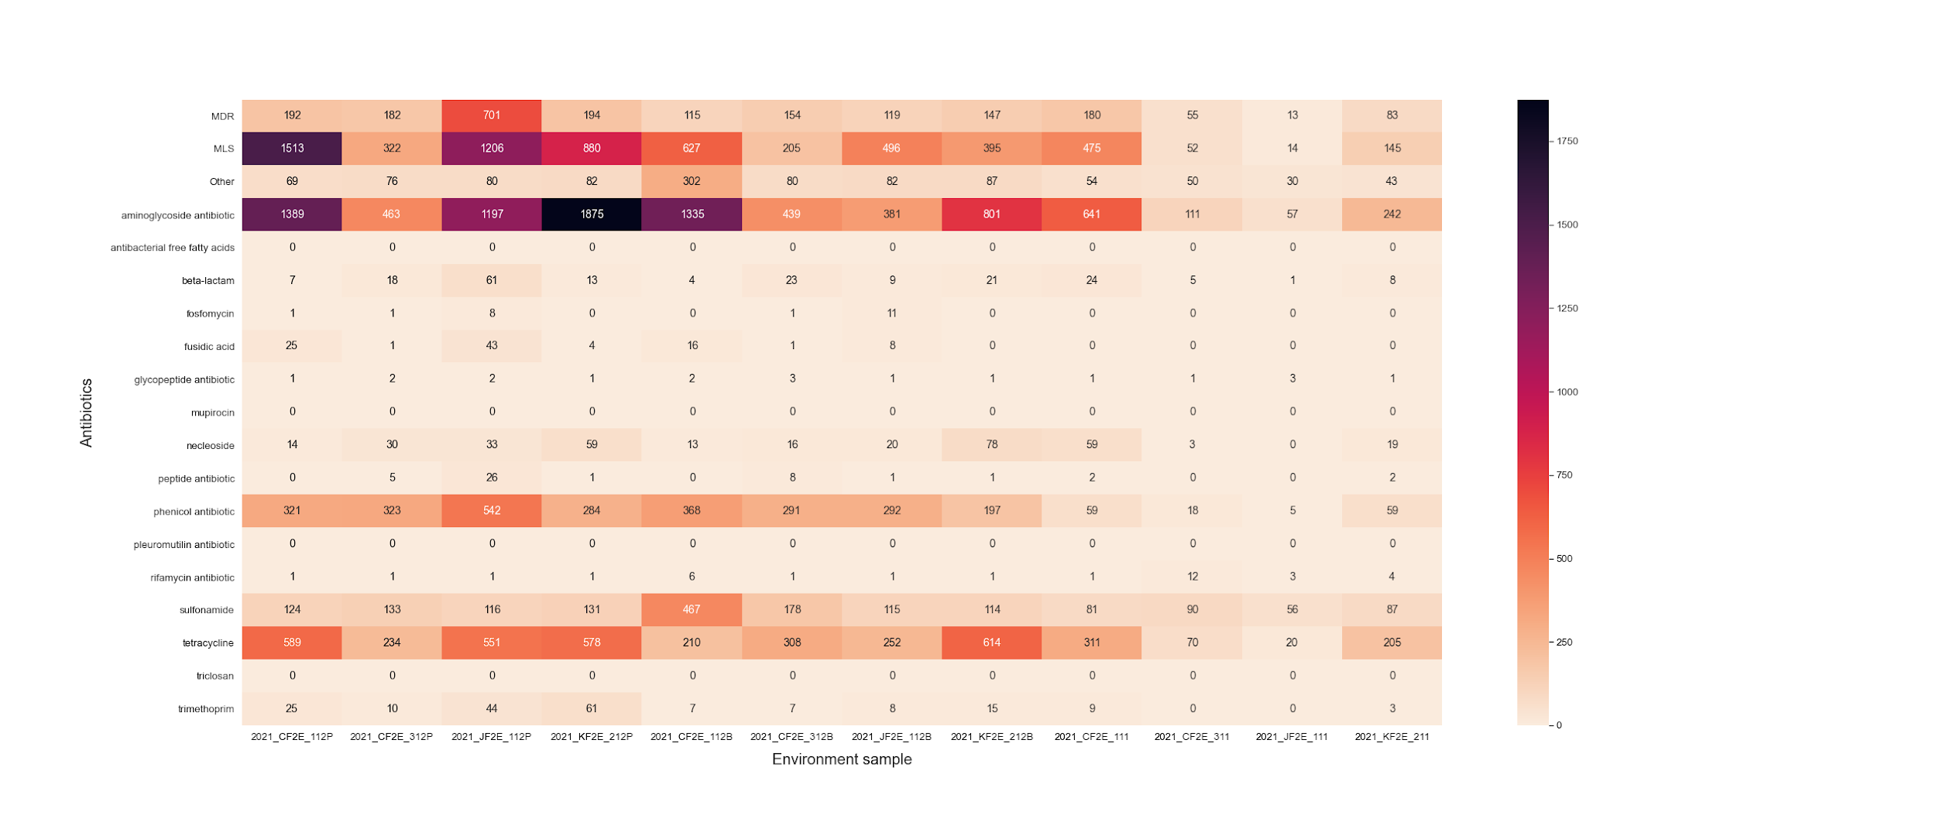
Animal sample
Major : MDR, MLS, aminoglycoside antibiotic,
phenicol, sulfonamide, tetracycline
Except for tetracycline, the antibiotics in the fecal samples
tend to be higher than those in the nasal samples.
Environment sample
Major : MDR, MLS, aminoglycoside antibiotic,
phenicol, sulfonamide, tetracycline
Human sample
Major : MDR, MLS, aminoglycoside antibiotic, beta-lactam,
fosfomycin, peptide antibiotic
Except for tetracycline, the antibiotics in the fecal samples
tend to be higher than those in the nasal samples.
Antibiotics
Animal samples
Antibiotics with high concentrations only in human samples
: beta-lactam, fosfomycin, peptide antibiotic
Antibiotics with high concentrations in environment and human samples except human samples
: phenicol, sulfonamide
Antibiotics common in all 3 samples
: MDR, MLS, tetracycline
Antibiotics
Antibiotics
Environment samples
Human samples

Slide 9
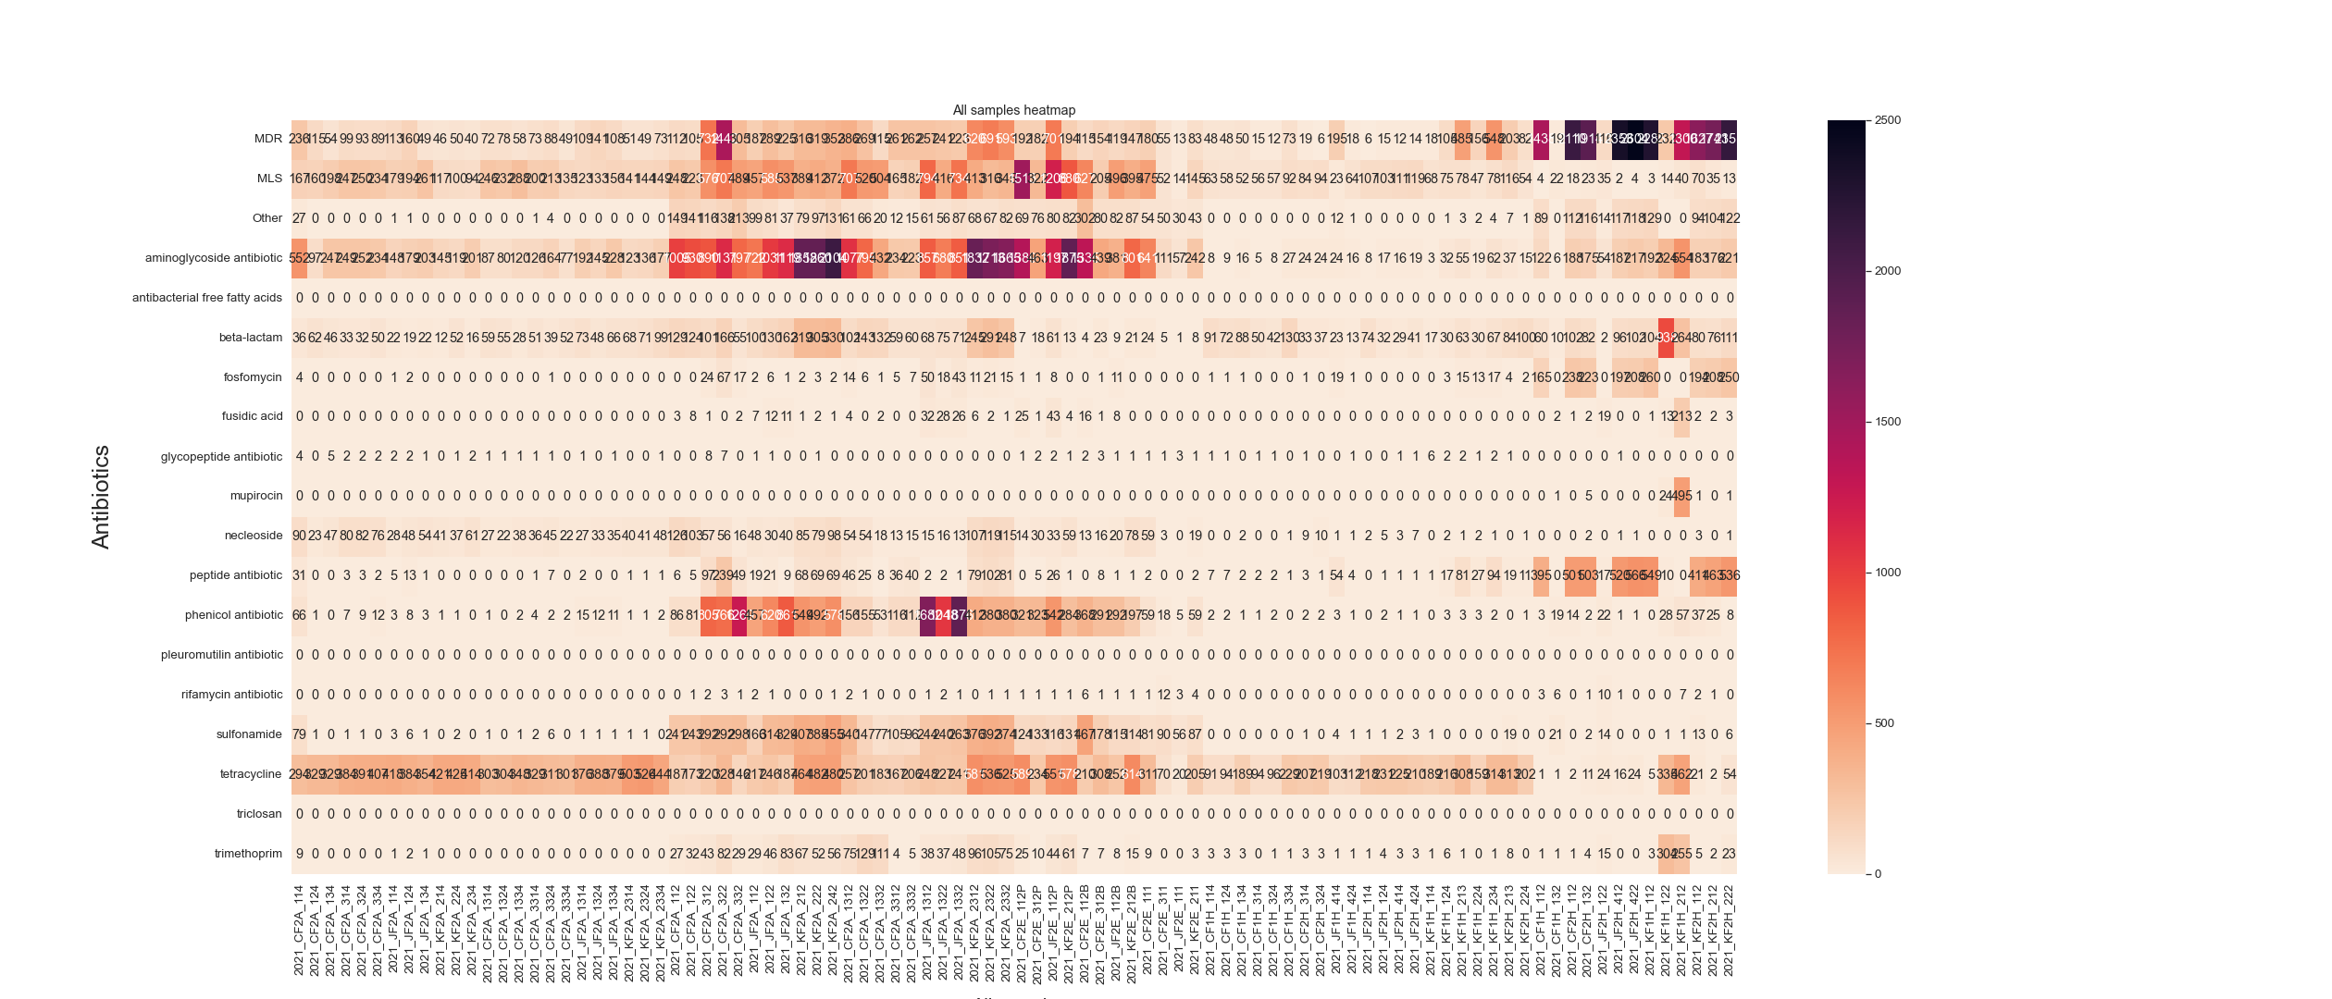
Antibiotics
Lactating pig
Finishing pig
Lactating pig
Finishing pig
Lactating
pig farm
Waste
water
Fecal
Nasal
Finishing
pig farm
Fecal
Nasal
Animal
Environment
Human

Slide 10
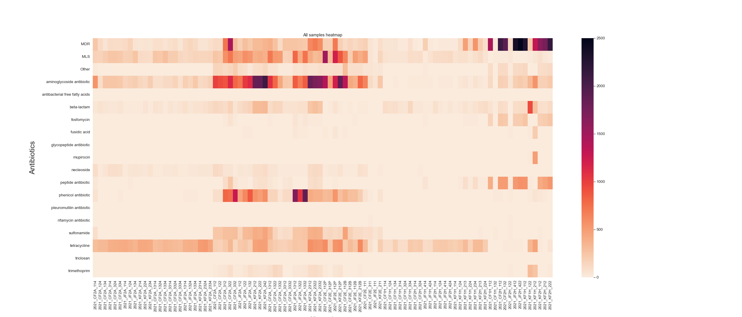
Antibiotics
Lactating pig
Finishing pig
Lactating pig
Finishing pig
Lactating
pig farm
Waste
water
Fecal
Nasal
Finishing
pig farm
Fecal
Nasal
Animal
Environment
Human

Slide 11
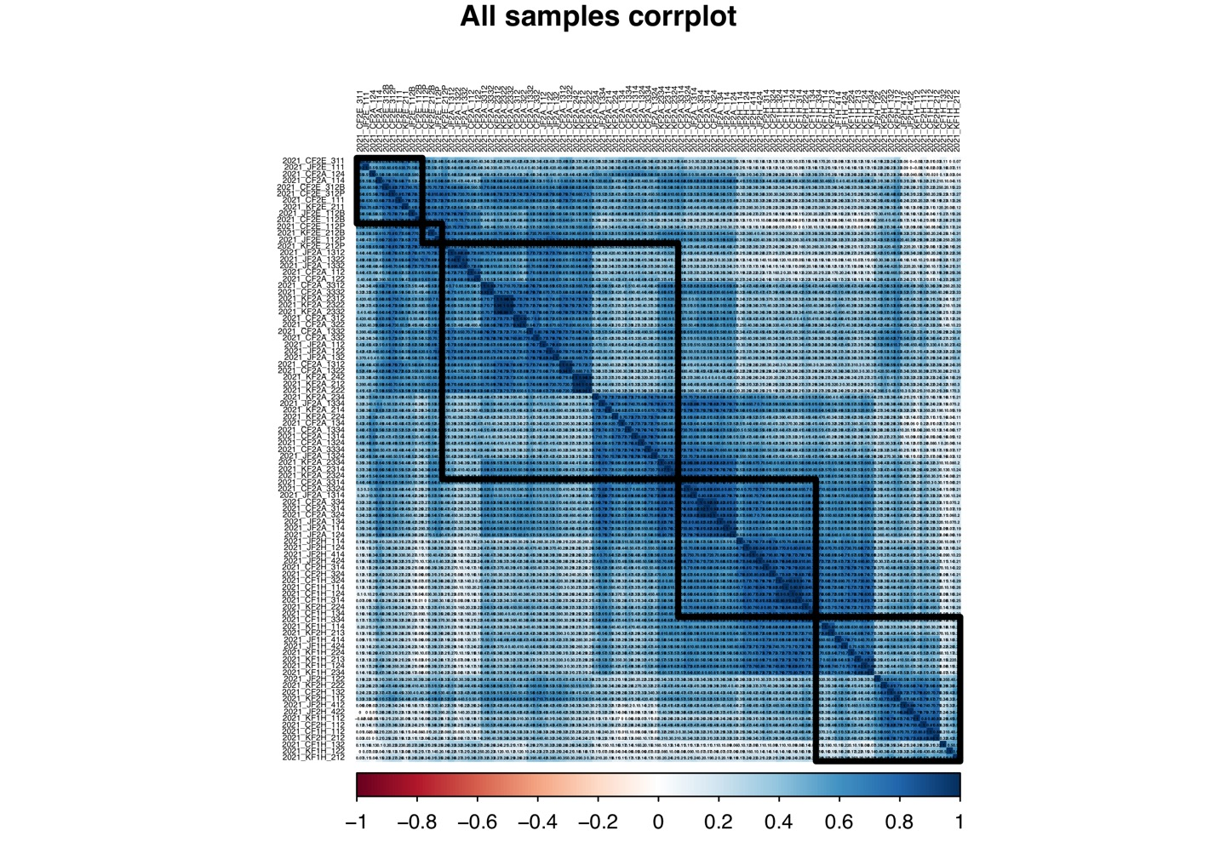
This figure shows a correlation plot using each gene of the samples.
Randomly list the samples and sort them using “hclust”; hierarchical clustering order
Draw 5 rectangles around the plot based on the results of hierarchical clustering.
Genes with a gene sum of less than 1 in the samples were excluded
1 : Animal &Environment samples are clustered
2 : Environment samples are clustered
3 : Animal samples are clustered
4 : Animal & Human samples are clustered
5 : Human samples are clustered
Some animal & environment samples have similar correlation coefficient
Some animal & Human samples have similar correlation coefficient
There are no red areas. This means all samples have positive correlation
A & E
Environment samples
Animal samples
A & H
Human samples

Slide 12
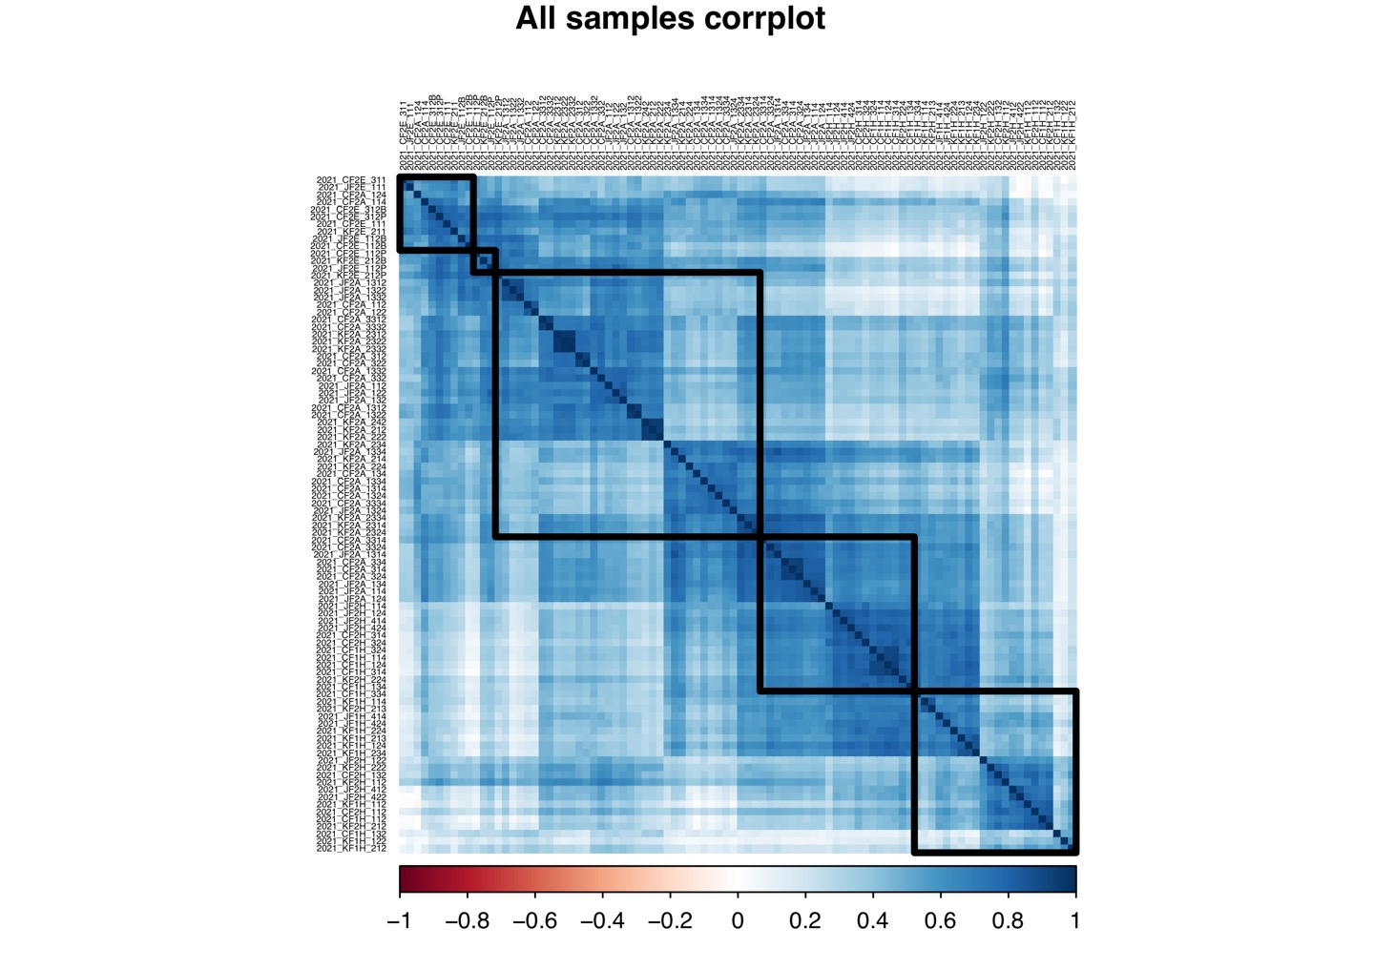
This figure is the same as the previous figure except for the detailed numbering

Slide 13
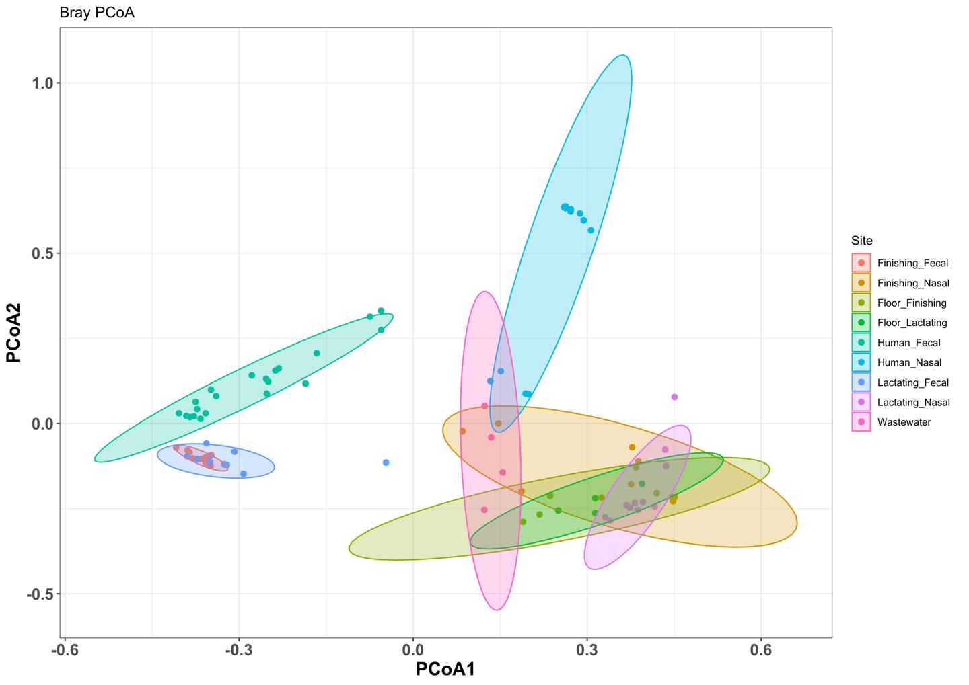
Anosim significance = 0.001

Slide 14
Lactating_fecal & finishing_fecal cluster overlap
Human_nasal & waste water & finishing_nasal cluster overlap
Waste water & floor_lactating & floor_finishing cluster overlap
Finishing_nasal & floor_finishing & lactating_nasal & floor_lactating cluster overlap
2
1
4
3

Slide 15
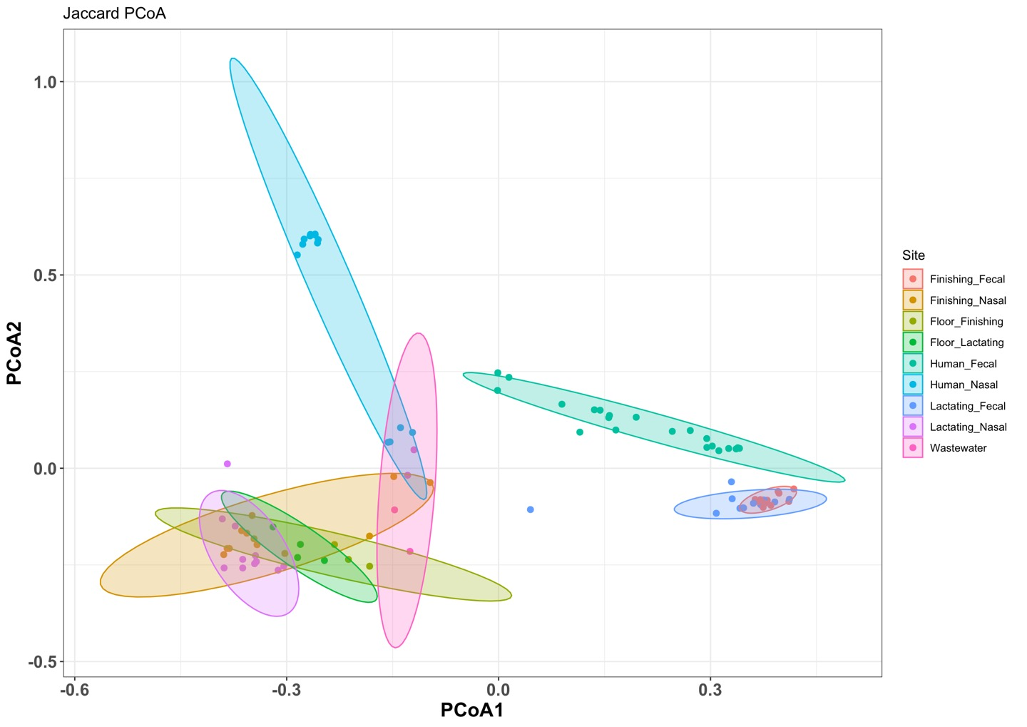
Anosim significance = 0.001

Slide 16
Floor_finishing & Floor_lactating & lactating_Nasal & finishing_Nasal cluster overlap
Finishing nasal & human nasal & waste water cluster overlap
Floor_finishing & waste water cluster overlap
Lactating fecal & Finishing fecal cluster overlap
2
1
3
4

Slide 17
Summary

